Slide 1
VEHICLE BREAKDOWN ASSISTANCE MANAGEMENT SYSTEM

Slide 2
Abstract
Today most of people use their own vehicle for travel. While travelling most of us are troubling with breakdown of our vehicle on the road. This is a worst experience that they have to face. When our vehicle suddenly breakdown on the road, the user have to search for mechanic and have to see a spare-part shops near to their location. At that time we can’t able to search for a good mechanic and we have to arrange some other transportation. By using this application the user can find suitable mechanic. The most advantage is the user can find a mechanic based on their user location and make payment. Varun Kapadi, SaigitaGuruju, Bhupesh Bojja, Prof. NilimaNikam had discussed about the application which directly connect with google GPS system and it shows the users current location. This project will show the name and address or location of all hospital those are in the range and the user can able to select any one hospital. VibhaviArtigala, H.DhanukaNadeeshani have discussed about the application Helpme.

Slide 3
EXISTING SYSTEM:
A car breakdown service station locator system is connected Car Repair Service Provider (CRSP). The user could enter information with the place of breakdown into the system and it will automatically search for nearby Car Repair Service Provider who registered with the system. The On-Road Vehicle Breakdown Assistance is like a car breakdown service station locator. But there is a chat platform to discuss the type of breakdown and exchange ideas about vehicle breakdown. In this system only provide the service only the car. The user’s information should loss and the services is not effective. There is no existing road side assistance for all the vehicles. only certain manufacturers provide this service that too only for high end cars. Used cars or old cars don’t have this facility.

Slide 4
Disadvantages
user needs to gather the mechanic related information through friends or through website.
It increases the human work and user could not easily identify the mechanic details and get help from that workshop.
Though the mechanic details provided by the mechanic may vary by its location of workshop.
User could not find the nearby location of mechanic and get help they required on time.

Slide 5
PROPOSED SYSTEM:
The proposed application helps to find mechanics easily and quickly. It is difficult to find mechanics nearby area wherever you are travelling. This system helps to overcome this issue by providing mechanic details in one click. Here the locator allows you to search mechanics from different locations. Admin is allowed to access and manage mechanic details. This online mechanic locator reduces work and can easily find the mechanics from various location. Reduces your time and cost. The main objective is to provide a better service and to make the process easily and finally appointing a mechanic quickly. Proposed system is accessed by three entities namely, Admin, Mechanic and User. A mechanic can perform task such as viewing request received from users and can also send feedback to the admin. User can send a request and can appoint a mechanic on respective date-time.
.

Slide 6
Advantage:
It is one of the best applications used while emergency
Easy to use.
Provides both locations nearby needs.

Slide 7
MODULE DESCRIPTION
User modules:
Register
Login
Search Mechanic Details
View Google geo location
Post feedback
My profile
Admin modules:
Provide Approval
Mechanic modules:
Register
Login
Post Business
Manage Business
View feedback

Slide 8
The system after careful analysis has been identified to be presented with the following modules User, Administrator and Mechanic.
User
Register – User has to register their basic details to get access with this application service.
Login – Once they have registered they need to login to avail the service at the needy time.
ViewDetails – Logging in with the application will provide you the lists of mechanics that have the approval of the application.
Search records & call – So that the users can search the mechanic among the list according to their place and time.
Post feedback – After all the process every user has to give their feedback with this application to about their adopted service through this medium.
Administrator
Provide Approval – Administration has to give approval to the registering mechanic after verifying their licensing details for the effective service.

Slide 9
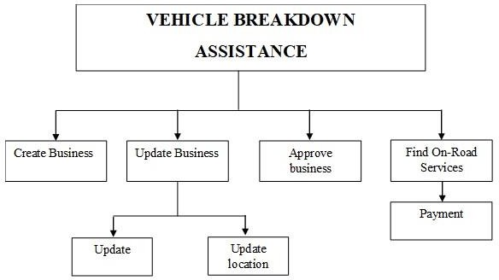
Mechanic
Register–At first every mechanic has to register their details with the admin for getting approval.
Login–Registered mechanics can login their accounts if they got their approval from the admin.
Post details–Here mechanics have to post their details like name, location, services available, etc.
View feedback– Using the feedbacks provided by the users/customers of the service mechanics have to maintain or improve their service.
System Architecture

Slide 10
SYSTEM REQUIREMENTS:
HARDWARE REQUIREMENTS
• Processor • Pentium IV and above
• Processor Speed • 1.4 Hz
• Ram Size • 1 GB
• Hard Disk Size • 80GB
SOFTWARE REQUIREMENTS
Operating System : Windows 7 Ultimate / Professional
Programming Language : PHP, HTML,
Scripting language : Java Script
DataBase : MySQL Database and MySQL utilities

Slide 11
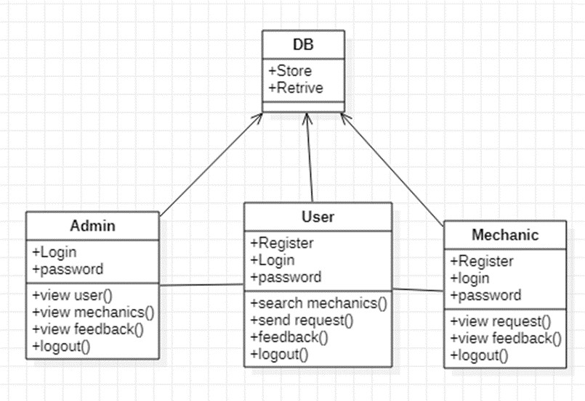
UML DIAGRAMS
Class Diagram

Slide 12
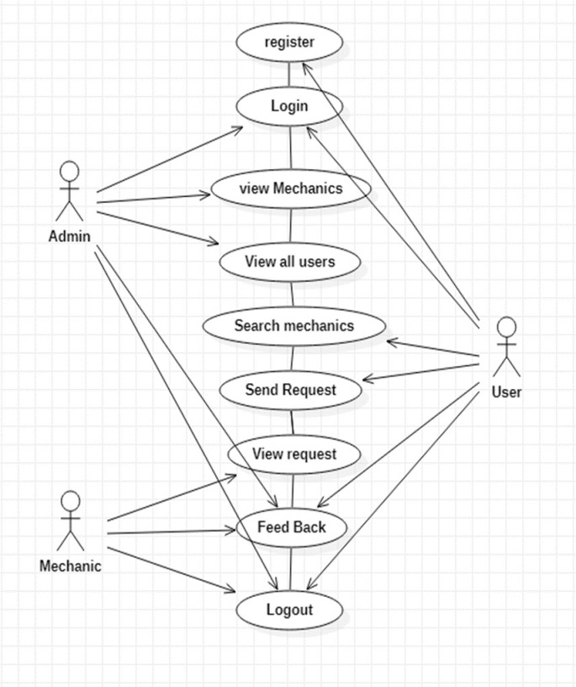
. Use case diagram

Slide 13
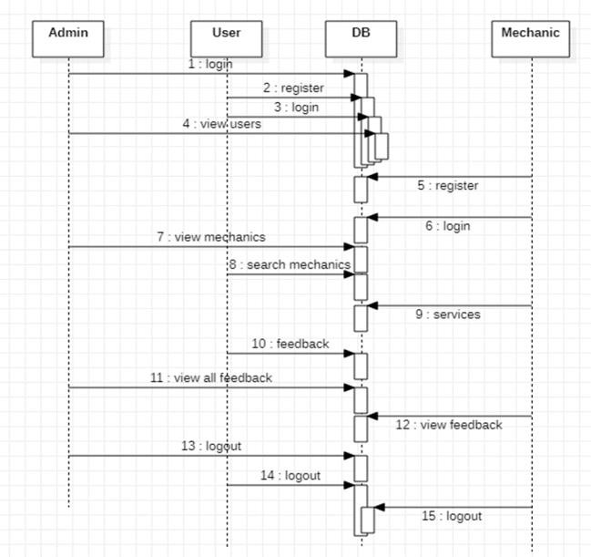
Sequence Diagram

Slide 15
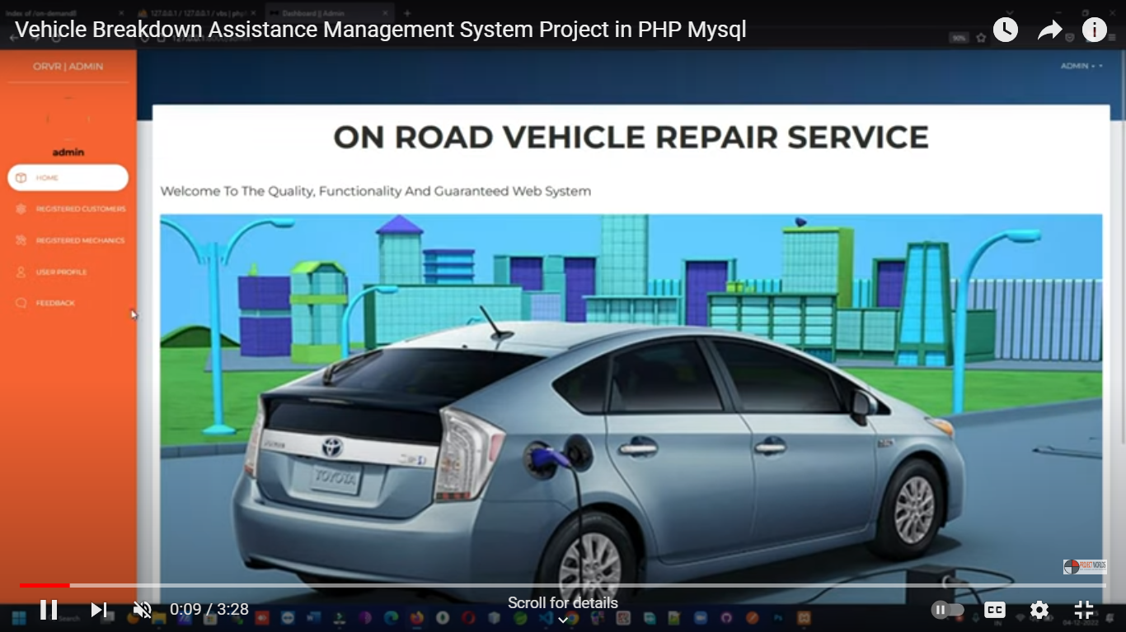
SCREEN LAYOUTS

Slide 16
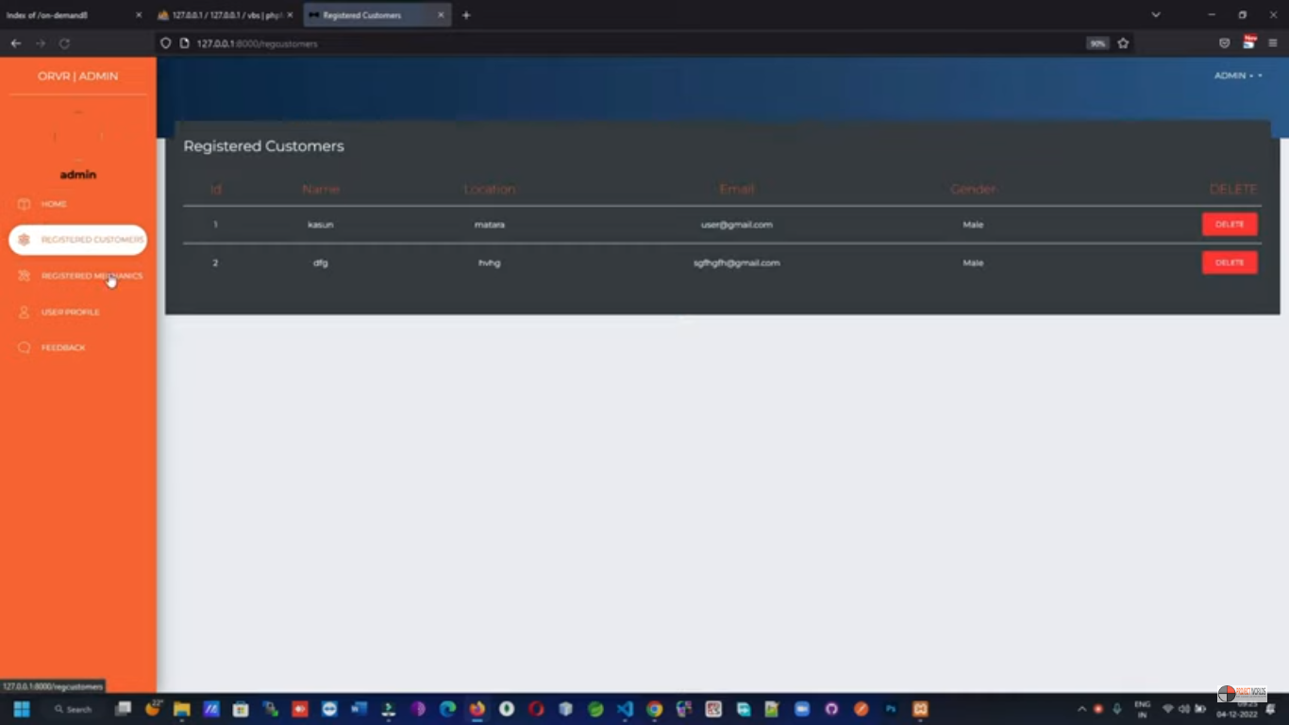

Slide 17
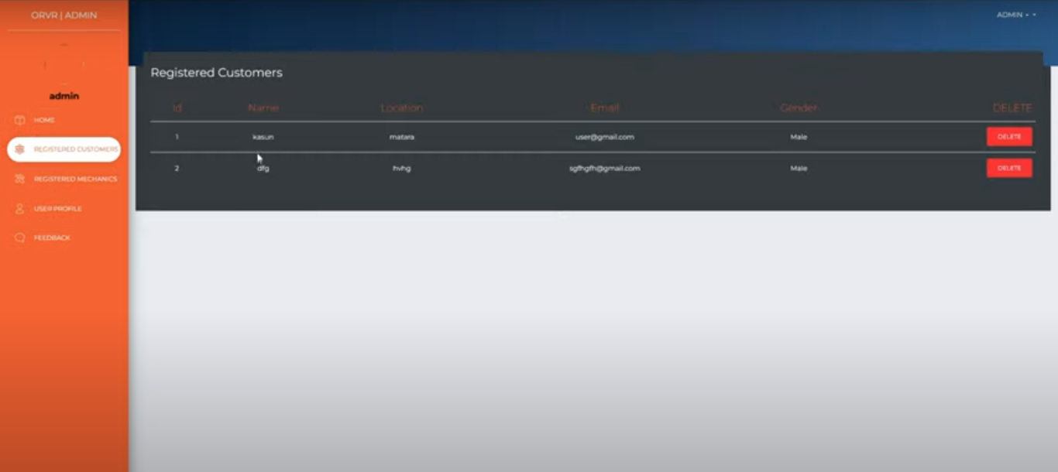

Slide 18
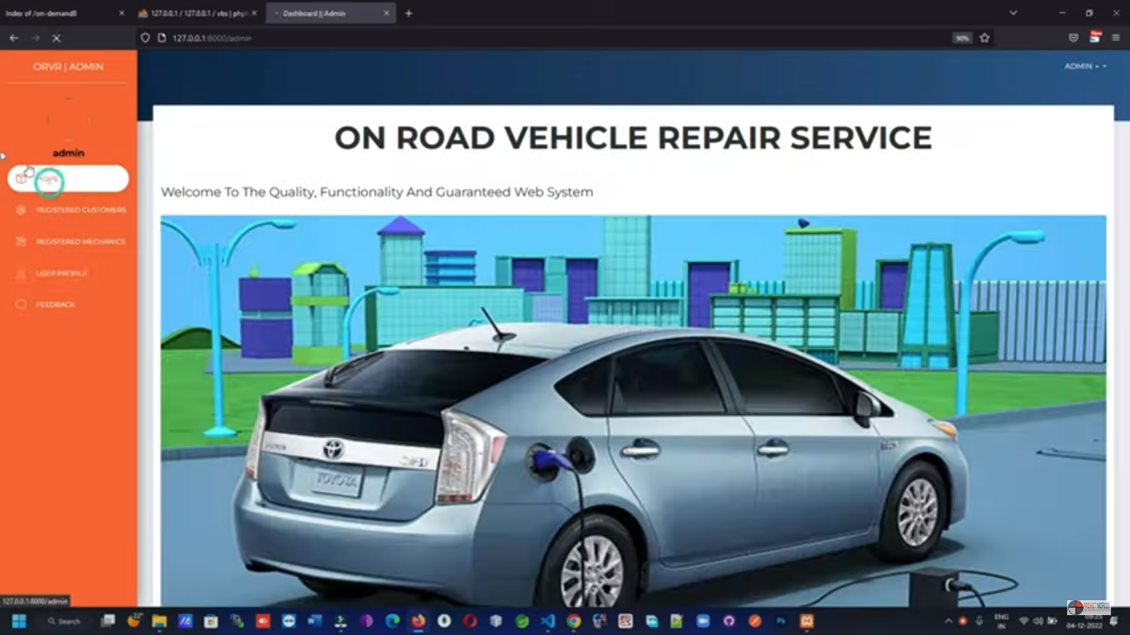

Slide 19
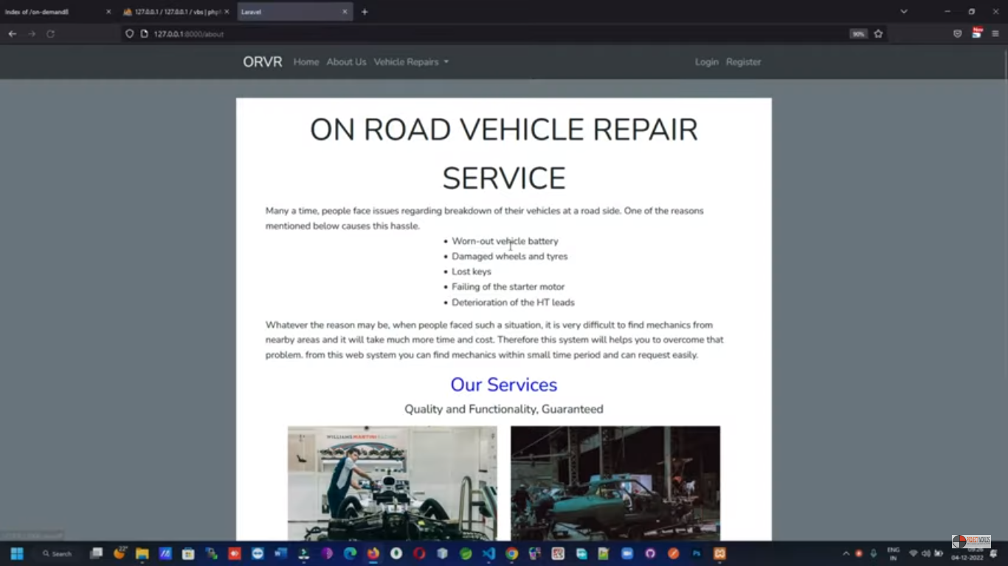

Slide 20
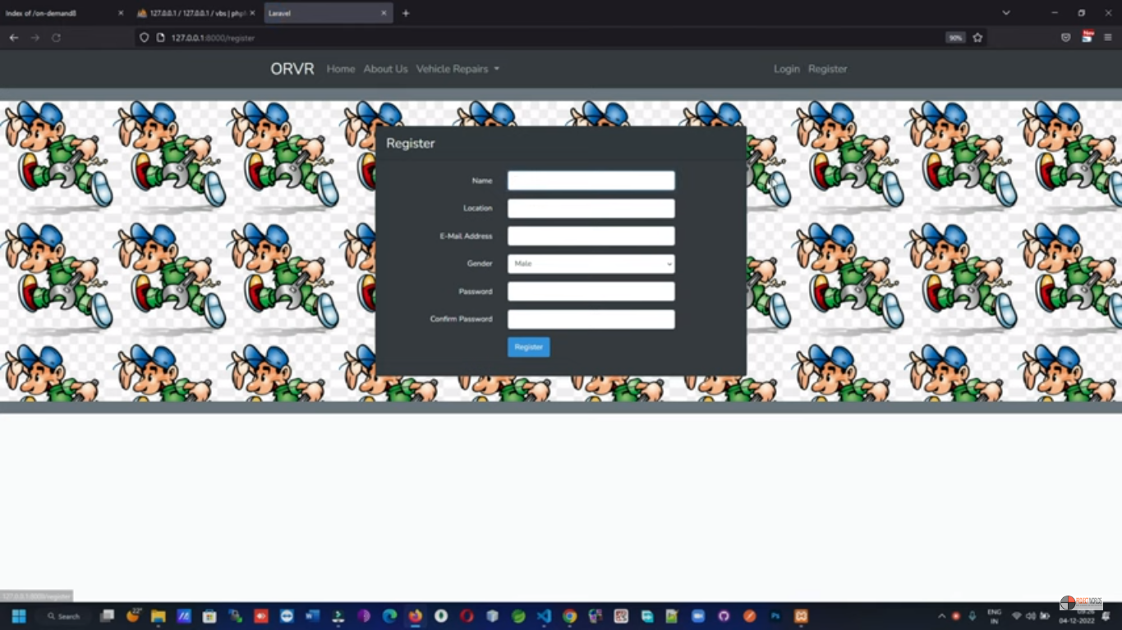

Slide 21
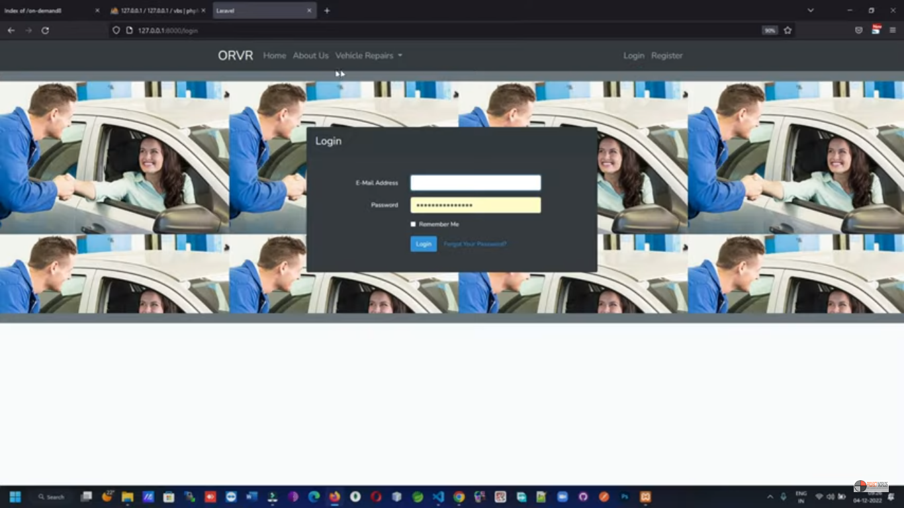

Slide 22
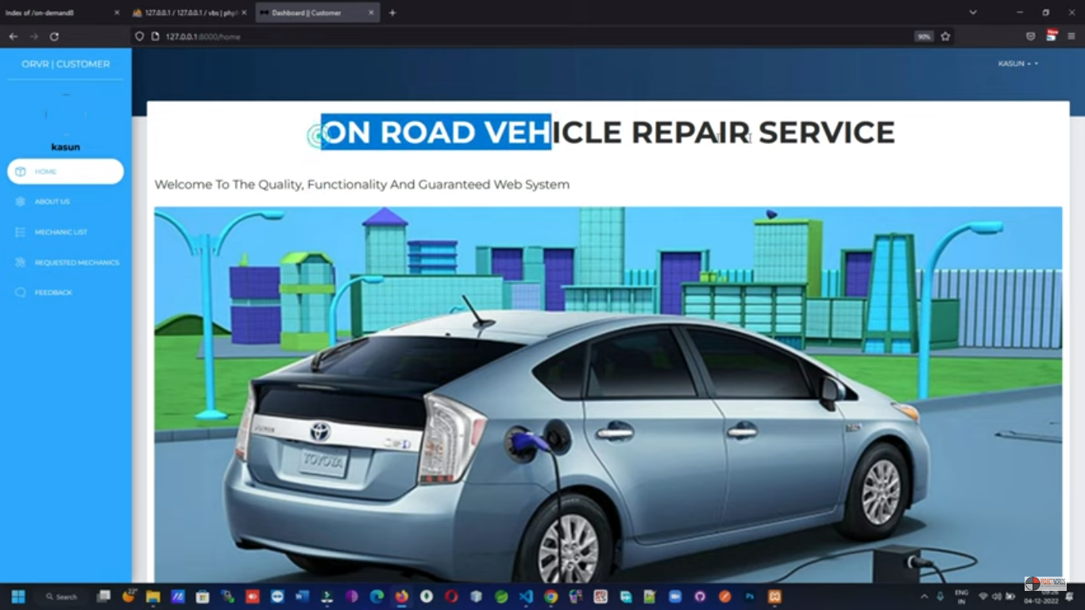

Slide 23
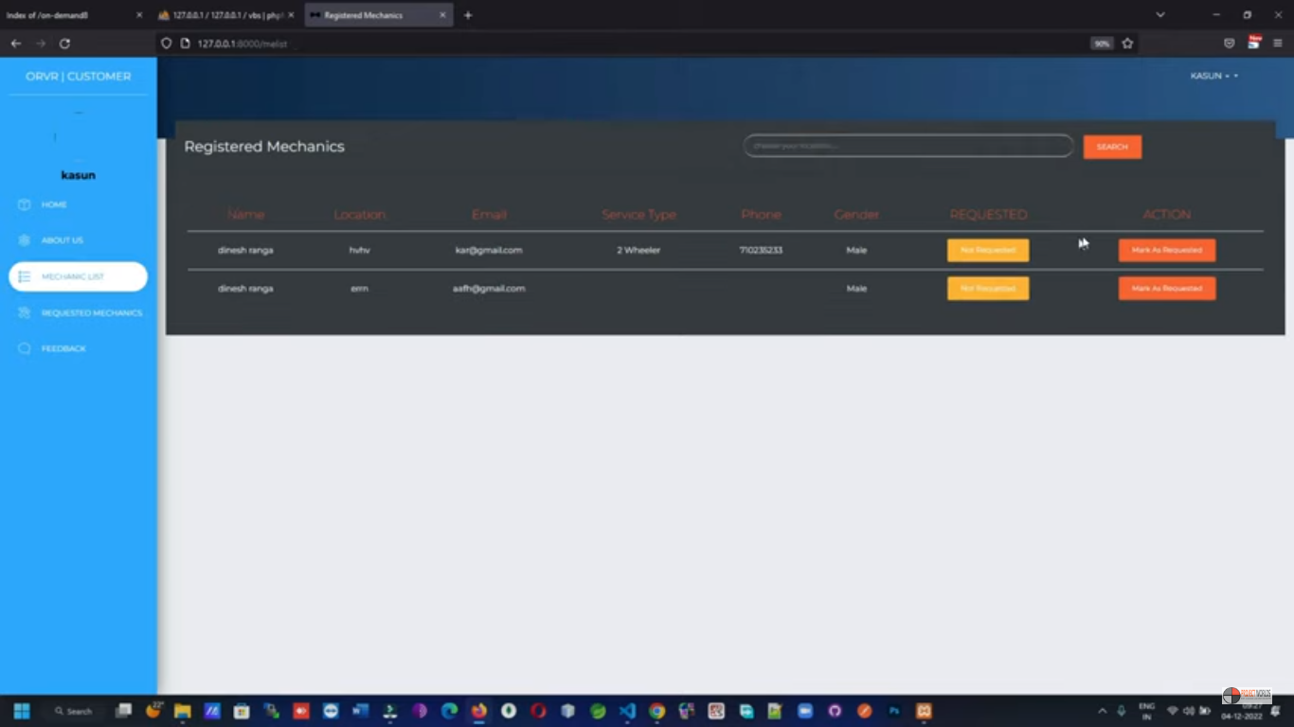

Slide 24


Slide 25
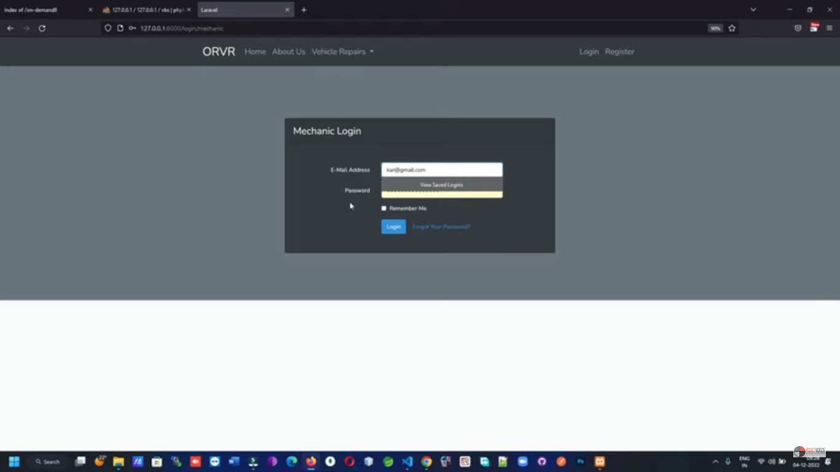

Slide 26
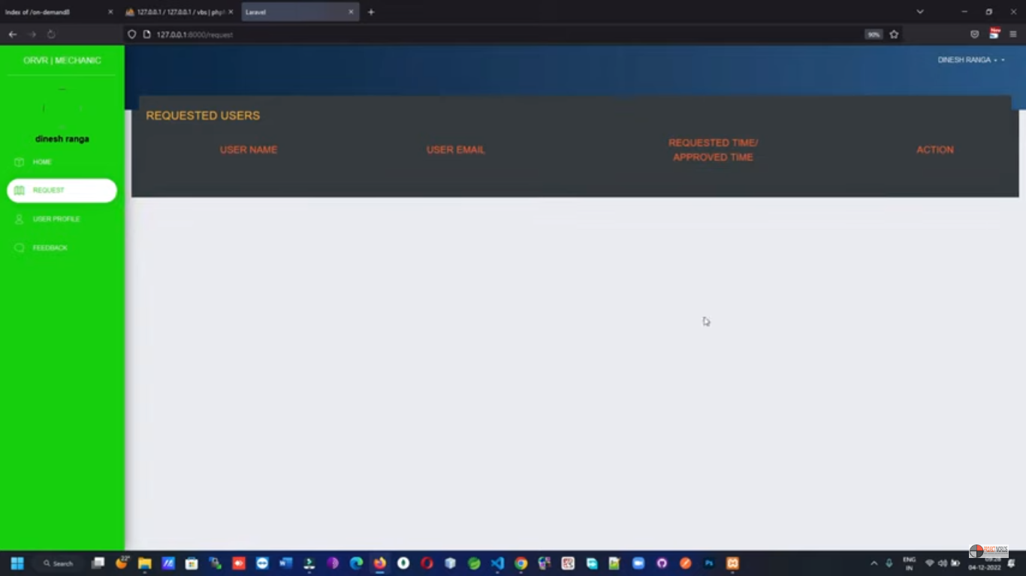

Slide 27
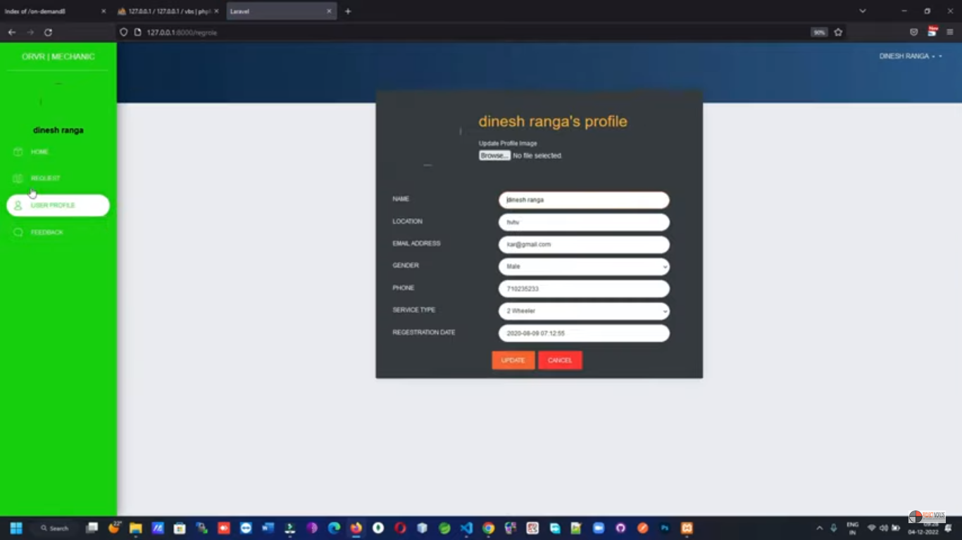

Slide 28
CONCLUSION
When the vehicle breakdown occurs the driver have to see a mechanic or the repair shop. The driver has to ask for help from the people. By using this application, the user can find mechanic based on user location. The user can get the mechanical help directly and easily. This is help to save user’s time while the traveling. When the breakdown occur, user can fix their vehicle immediately. That make comfortable the user. They won’t make tired their journey.
In Future, the vehicle and spareparts shop will be categorized according to the vehicle model. That is help to user found their spare-parts according to the type of the vehicle by saving their time. In addition to that the list of hospitals and Fuels stations can be added.

